Slide 1
Chapter 4
Sequential Containers

Slide 2
Chapter Objectives
To become familiar with the Standard Template Library (STL) and template classes
To understand how to use a vector class and how to implement it using an array for storage
To understand the difference between a shallow copy and deep copy
To introduce linked lists and study the differences between single-, double-, and circular linked list data structures
To introduce structs

Slide 3
Chapter Objectives (cont.)
To understand the iterator
To learn how to implement the STL list class
To learn how to implement the iterator for a linked list
To learn how to declare aliases and use delegation
To become familiar with the STL sequential containers
To introduce the functions in the algorithm header

Slide 4
Introduction
So far we’ve considered one data structure that you can use in your programming—the array
The C++ developers have provided more tools for programmers by providing a rich set of data structures written as C++ template classes
These template classes are all part of the Standard Template Library (STL)
In this chapter we discuss the STL classes called sequences

Slide 5
Introduction (cont.)
A sequence has the property that elements can be inserted or removed anywhere in the sequence, not just at the beginning or at the end
Some sequences are indexed, which means their elements can be accessed in arbitrary order (called random access) using a subscript to select an element
For other sequences you must start at the beginning and process the elements in order

Slide 6
Introduction (cont.)
In this chapter, we
discuss iterators and their role in facilitating sequential access and random access
discuss the vector and list (linked list) classes and their similarities and differences
show that these classes implement the common interface requirements for sequential containers

Slide 7
Template Classes and the Vector
Section 4.1

Slide 8
Template Classes and the Vector
A template class is a class that stores and processes a collection of information
template<typename T>
class some_container { ... }

Slide 9
Template Classes and the Vector (cont.)
A template class is a class that stores and processes a collection of information
template<typename T>
class some_container { ... }
In this code, some_container is declared to be a template class

Slide 10
Template Classes and the Vector (cont.)
A template class is a class that stores and processes a collection of information
template<typename T>
class some_container { ... }
The parameter T is a placeholder for the actual data type of the information to be stored in some_container

Slide 11
Template Classes and the Vector (cont.)
A template class is a class that stores and processes a collection of information
template<typename T>
class some_container { ... }
some_container<int> call_lengths;
some_container<Person> people;

Slide 12
Template Classes and the Vector (cont.)
A template class is a class that stores and processes a collection of information
template<typename T>
class some_container { ... }
some_container<int> call_lengths;
some_container<Person> people;
These two lines each create instances of some_container

Slide 13
Template Classes and the Vector (cont.)
A template class is a class that stores and processes a collection of information
template<typename T>
class some_container { ... }
some_container<int> call_lengths;
some_container<Person> people;
call_lengths stores a collection of int values

Slide 14
Template Classes and the Vector (cont.)
A template class is a class that stores and processes a collection of information
template<typename T>
class some_container { ... }
some_container<int> call_lengths;
some_container<Person> people;
people stores a collection of Person objects

Slide 15
Template Classes and the Vector (cont.)
A template class is a class that stores and processes a collection of information
template<typename T>
class some_container { ... }
some_container<int> call_lengths;
some_container<Person> people;
The same operations can be performed on both instances. At compile time, the actual data type is substituted for the parameter T to create the desired instantiation of some_container.

Slide 16
Vector
The vector template class is an improvement over an array
A vector is based on an array which means you can select its elements in arbitrary order as determined by the subscript value
A vector supports the following operations that an array does not:
Increase or decrease its length
Insert an element at a specified position without writing code to shift the other elements to make room
Remove an element at a specified position without writing code to shift the other elements to fill in the resulting gap

Slide 17
Vector (cont.)
Vectors are used most often when a programmer wants to add new elements to the end of a list but still needs the capability to access the elements stored in the list in arbitrary order
We needed these for our telephone directory application:
New entries were added at the end
We needed to find numbers for entries already in the directory

Slide 18
Vector (cont.)
The size of a vector automatically increases as new elements are added to it, and the size decreases as elements are removed
If an insertion is not at the end of the vector, the existing entries in the vector are shifted automatically to make room for the entry being inserted
Similarly, if an element other than the last one is removed, the other entries are shifted automatically to close up the space that was vacated

Slide 19
Vector (cont.)
The the number of elements a vector currently contains is returned by the member function size
Each vector object also has a capacity, which is the number of elements it can store
When a vector’s size is equal to its capacity, the capacity is increased automatically
vector is a template class, so you can declare vector objects to hold objects of any other type
To declare my_vector to be a vector containing strings, you use the declaration
vector<string> my_vector;

Slide 20
Vector (cont.)
To allocate storage for a vector whose elements are String objects:
vector<String> my_vector;
Initially my_vector is empty
To add strings to the list,
my_vector.push_back("Bashful");
my_vector.push_back("Awful");
my_vector.push_back("Jumpy");
my_vector.push_back("Happy");

Slide 21


Vector (cont.)
Adding an element with subscript 2:
my_vector.insert(2, "Doc");
Notice that the subscripts of "Jumpy" and "Happy" have changed from [2],[3] to [3],[4]

Slide 22
Vector (cont.)
To add to the end of the list:
my_vector.push_back("Dopey");

Slide 23

Vector (cont.)
Removing an element:
my_vector.erase(1);
The strings referenced by [2] to [5] have changed to [1] to [4]

Slide 24
Vector (cont.)
A vector is an indexed container; you can access its elements using a subscript
string dwarf = my_vector[2];
stores the string object "Jumpy" in variable dwarf, without changing my_vector

Slide 25

Vector (cont.)
You can also replace an element:
my_vector[2] = "Sneezy";

Slide 26
Specification of the vector Class
The vector class is part of the standard library and is specified in the header <vector>
In the C++ standard library there is a second template parameter, called the allocator for which the library provides a default value that is adequate for most purposes
Further discussion of the use of the allocator can be found in Appendix A
The following table shows a subset of the functions defined in the vector class

Slide 27
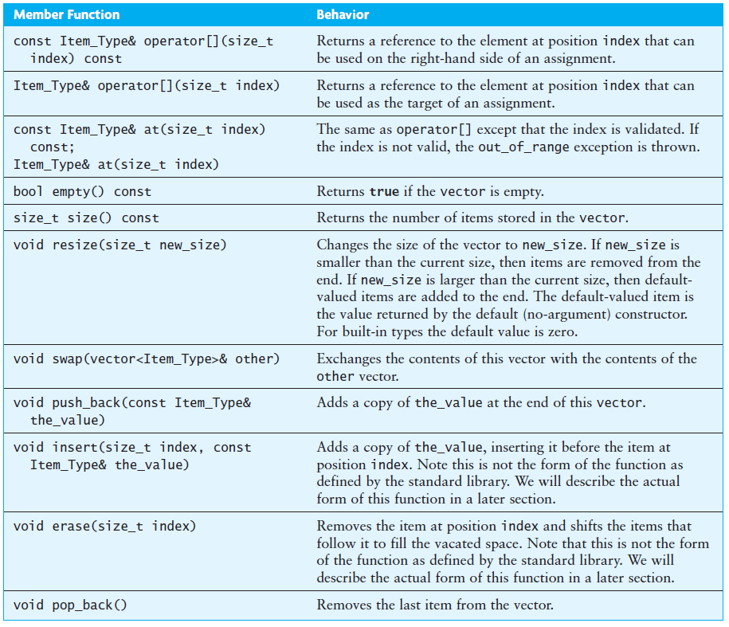
Specification of the vector Class

Slide 28
Specification of the vector Class
Because Item_Type is determined when the vector is created, the actual argument types and return types for these functions may be different for different instantiations of the vector class
(Recall that the size_t type is an unsigned int; we use it here because all vector indexes must be nonnegative)
The functions insert and erase are defined differently in the standard library, but the form shown in the table is what we will implement in Section 4.3
At the end of this chapter we revisit the vector and discuss how to modify our sample implementation to be like the standard one

Slide 29
Function at and the Subscripting Operator
There are two entries in preceding table for the subscripting operator [] and two for the member function at
The first entry for each returns the value of the specified vector element (indicated by the keyword const at the beginning and end of these entries); this value can’t be changed
The second entry for each is a reference to an element of the vector; its value can be changed

Slide 30
Function at and the Subscripting Operator (cont.)
Both of the following statements retrieve and display the value of element 2 of vector<int> v
cout << v[2];
cout << v.at(2);
Both of the following statements add 6 to the value of element 2 of vector v and assign that sum to element 3 of vector v
v[3] = v[2] + 6;
v.at(3) = v.at(2) + 6;
In these statements, the reference to element 2 retrieves a value of vector v that is not changed
In contrast, both references to element 3 change its value

Slide 31
Applications of vector
Section 4.2

Slide 32
Applications of vector
vector<int> some_ints;
int nums[] = {5, 7, 2, 15};
for (int i = 0; i < 4; i++)
some_ints.push_back(nums[i]);
These statements store a collection of int values in vector some_ints

Slide 33
Applications of vector
vector<int> some_ints;
int nums[] = {5, 7, 2, 15};
for (int i = 0; i < 4; i++)
some_ints.push_back(nums[i]);
After the loop finishes, vector element some_ints[i] and array element nums[i] (for all i in range) will contain the same value

Slide 34
Applications of vector
int sum = 0;
for (size_t i = 0; i < some_ints.size(); i++) {
sum += some_ints[i];
}
cout << "sum is " << sum << endl;
This fragment finds and displays
the sum of the int values in some_ints

Slide 35
Applications of vector
int sum = 0;
for (size_t i = 0; i < some_ints.size(); i++) {
sum += some_ints[i];
}
cout << "sum is " << sum << endl;
Although it may seem wasteful to carry out these operations when you already have an array of ints, the purpose of this example is to illustrate the steps needed to process a collection of int values in a vector

Slide 36
The Phone Directory Application Revisited
In Chapter 1 we created a phone directory by building an array of phone directory entries that expanded as new directory entries were added
We can accomplish the same operations much more easily using a vector to store the phone directory:
vector<Directory_Entry> the_directory;
Instead of creating a function to reallocate the size of the array when we need to add an item when the array is full, we can simply use a vector :
/** Adds a new entry.
@param name The name of the person being added
@param new_number The new number to be assigned
*/
void add(string name, string new_number) {
Directory_Entry new_entry(name, new_number);
the_directory.push_back(new_entry);
}

Slide 37
Implementation of a vector Class
Section 4.3

Slide 38
Implementation of a vector Class
namespace KW {
template<typename Item_Type>
class vector {
private:
// Data fields
/** The initial capacity of the array */
static const size_t INITIAL_CAPACITY = 10;
/** The current capacity of the array */
size_t current_capacity;
/** The current num_items of the array */
size_t num_items;
/** The array to contain the data */
Item_Type* the_data;
public:
// Member Functions
...
};
};
We will implement a simplified version of the vector class, which we will encapsulate
in the namespace KW

Slide 39
Implementation of a vector Class (cont.)
namespace KW {
template<typename Item_Type>
class vector {
private:
// Data fields
/** The initial capacity of the array */
static const size_t INITIAL_CAPACITY = 10;
/** The current capacity of the array */
size_t current_capacity;
/** The current num_items of the array */
size_t num_items;
/** The array to contain the data */
Item_Type* the_data;
public:
// Member Functions
...
};
};
Our vector will be called KW::vector to distinguish it from the standard vector, std::vector

Slide 40
Implementation of a vector Class (cont.)
namespace KW {
template<typename Item_Type>
class vector {
private:
// Data fields
/** The initial capacity of the array */
static const size_t INITIAL_CAPACITY = 10;
/** The current capacity of the array */
size_t current_capacity;
/** The current num_items of the array */
size_t num_items;
/** The array to contain the data */
Item_Type* the_data;
public:
// Member Functions
...
};
};
The physical size of the array is indicated by the data field current_capacity (type size_t because it must be non-negative)

Slide 41
Implementation of a vector Class (cont.)
namespace KW {
template<typename Item_Type>
class vector {
private:
// Data fields
/** The initial capacity of the array */
static const size_t INITIAL_CAPACITY = 10;
/** The current capacity of the array */
size_t current_capacity;
/** The current num_items of the array */
size_t num_items;
/** The array to contain the data */
Item_Type* the_data;
public:
// Member Functions
...
};
};
The number of data items stored is indicated by the data field num_items

Slide 42
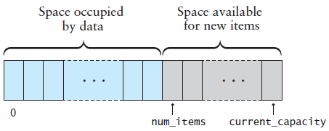
Implementation of a vector Class (cont.)
We use a C++ array internally to contain the data of a KW::vector
The elements between num_items and current_capacity are available for the storage of new items

Slide 43
The Default Constructor
Because this is a template class, all of the code must be in the header or in a file included by the header
The default constructor initializes the values of num_items and current_capacity and allocates the initial data array
/** Constructs an empty vector with the default
initial capacity.
*/
vector<Item_Type>() : current_capacity(INITIAL_CAPACITY),
the_data(new Item_Type[INITIAL_CAPACITY]), num_items(0) {}

Slide 44
The swap Function
The swap function exchanges the value of this vector object with another vector object
It uses the standard template function to swap the values
/** Exchanges the contents of this vector with another.
@param other The other vector
*/
void swap(vector<Item_Type>& other) {
std::swap(num_items, other.num_items);
std::swap(current_capacity, other.current_capacity);
std::swap(the_data, other.the_data);
}

Slide 45
The Subscripting Operator
Two forms of the subscripting operator are provided:
one to return a modifiable reference to an item in the vector
the other to return a nonmodifiable reference
The declaration for the former is:
Item_Type& operator[](size_t index) {
and the declaration for the latter is:
const Item_Type& operator[](size_t index) const {

Slide 46
The Subscripting Operator (cont.)
Two forms of the subscripting operator are provided:
one to return a modifiable reference to an item in the vector
the other to return a nonmodifiable reference
The declaration for the former is:
Item_Type& operator[](size_t index) {
and the declaration for the latter is:
const Item_Type& operator[](size_t index) const {
In the second declaration, the modifier const appears both before the return type and after the function signature

Slide 47
The Subscripting Operator (cont.)
Two forms of the subscripting operator are provided:
one to return a modifiable reference to an item in the vector
the other to return a nonmodifiable reference
The declaration for the former is:
Item_Type& operator[](size_t index) {
and the declaration for the latter is:
const Item_Type& operator[](size_t index) const {
The compiler invokes the const version whenever the subscripting operator is applied on the right-hand side of an assignment operation; it invokes the non-const version when the subscripting operator is applied on the left-hand side of an assignment

Slide 48
The Subscripting Operator (cont.)
The body of the code for both forms of the function is identical:
Item_Type& operator[](size_t index) {
// Verify that the index is legal.
if (index < 0 || index >= num_items) {
throw std::out_of_range
("index to operator[] is out of range");
}
return the_data[index]
}

Slide 49
The Subscripting Operator (cont.)
The body of the code for both forms of the function is identical:
Item_Type& operator[](size_t index) {
// Verify that the index is legal.
if (index < 0 || index >= num_items) {
throw std::out_of_range
("index to operator[] is out of range");
}
return the_data[index]
}
In our implementation we validate the value of the index, index. In the standard vector, the subscripting operator does not do this. Our implementation is equivalent to the standard vector function at

Slide 50
The Subscripting Operator (cont.)
Bjarne Stroustrup, the inventor of C++, suggests in his book, The C++ Programming Language, 3rd Edition, that programmers can define their own vector class that overcomes this limitation as follows.
template<typename Item_Type>
class my_vector : public std::vector<Item_Type> {
Item_Type& operator[](int index) {return at(index);}
const Item_Type& operator[](int index) const {
return at(index);}
}
}
The new template class my_vector is defined as an extension of the standard vector class
The subscript operators in the standard class are overridden with ones that apply function at

Slide 51
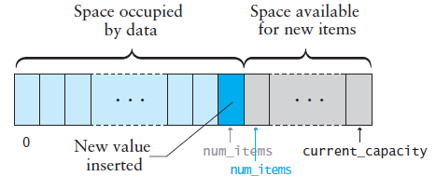
The push_back Function
The push_back function appends an item to the end of a vector
If num_items is less than current_capacity, then, to append a new item:
Insert the new item at the position indicated by the value of num_items
Increment the value of num_items

Slide 52
The push_back Function (cont.)
If num_items is already equal to current_capacity, we must first allocate a new array to hold the data and then copy the data to this new array
The member function reserve (explained shortly) does this

Slide 53
The push_back Function (cont.)
void push_back(const Item_Type& the_value) {
// Make sure there is space for the new item.
if (num_items == current_capacity) {
reserve(2 * current_capacity); // Allocate an expanded array
}
// Insert the new item.
the_data[num_items] = the_value;
num_items++;
}

Slide 54
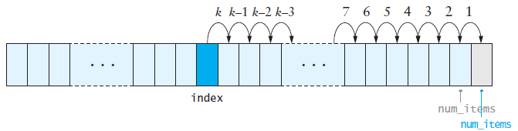
The insert Function
To insert into the middle of the array, the values at the insertion point are shifted over to make room, beginning at the end of the array and proceeding in the indicated order

Slide 55
The insert Function (cont.)
void insert(size_t index, const Item_Type& the_value) {
// Validate index.
if (index > num_items) {
throw std::out_of_range("index to insert is out of range");
}
// Ensure that there is space for the new item.
if (num_items == current_capacity) {
reserve(2 * current_capacity); // Allocate an expanded array
}
// Move data from index to num_items - 1 down.
for (size_t i = num_items; i > index; i--) {
the_data[i] = the_data[i - 1];
}
// Insert the new item.
the_data[index] = the_value;
num_items++;
}

Slide 56
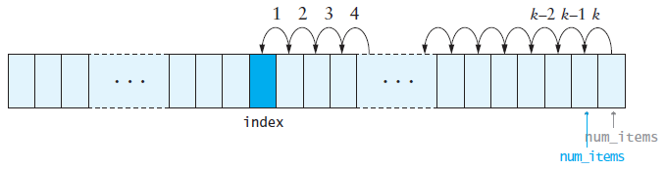
The erase Function
When an item is removed, the items that follow it must be moved forward to close the gap
Begin with the item closest to the removed element and proceed in the indicated order

Slide 57
The erase Function (cont.)
void erase(size_t index) {
// Validate index.
if (index > num_items) {
throw std::out_of_range
("index to insert is out of range");
}
// Move items below the removed one up.
for (size_t i = index + 1; i < num_items; i++) {
the_data[i - 1] = the_data[i];
}
num_items--;
}

Slide 58
The reserve Function
Create a new array that is twice the size of the current array and then copy the contents into the new array
void reserve(size_t new_capacity) {
if (new_capacity > current_capacity) {
if (new_capacity > 2 * current_capacity)
current_capacity = new_capacity;
else
current_capacity *= 2; // Double the capacity.
Item_Type* new_data = new Item_Type[current_capacity];
// Copy the data over.
for (size_t i = 0; i < num_items; i++)
new_data[i] = the_data[i];
// Free the memory occupied by the old copy.
delete[] the_data;
// Now point to the new data.
the_data = new_data;
}
}

Slide 59
The reserve Function (cont.)
Create a new array that is twice the size of the current array and then copy the contents into the new array
void reserve(size_t new_capacity) {
if (new_capacity > current_capacity) {
if (new_capacity > 2 * current_capacity)
current_capacity = new_capacity;
else
current_capacity *= 2; // Double the capacity.
Item_Type* new_data = new Item_Type[current_capacity];
// Copy the data over.
for (size_t i = 0; i < num_items; i++)
new_data[i] = the_data[i];
// Free the memory occupied by the old copy.
delete[] the_data;
// Now point to the new data.
the_data = new_data;
}
}
This statement releases the memory allocated to the array pointed to by the_data; we do this to prevent memory leaks

Slide 60
The reserve Function (cont.)
Create a new array that is twice the size of the current array and then copy the contents into the new array
void reserve(size_t new_capacity) {
if (new_capacity > current_capacity) {
if (new_capacity > 2 * current_capacity)
current_capacity = new_capacity;
else
current_capacity *= 2; // Double the capacity.
Item_Type* new_data = new Item_Type[current_capacity];
// Copy the data over.
for (size_t i = 0; i < num_items; i++)
new_data[i] = the_data[i];
// Free the memory occupied by the old copy.
delete[] the_data;
// Now point to the new data.
the_data = new_data;
}
}
Doubling spreads out the cost of copying

Slide 61
The reserve Function (cont.)
Create a new array that is twice the size of the current array and then copy the contents into the new array
void reserve(size_t new_capacity) {
if (new_capacity > current_capacity) {
if (new_capacity > 2 * current_capacity)
current_capacity = new_capacity;
else
current_capacity *= 2; // Double the capacity.
Item_Type* new_data = new Item_Type[current_capacity];
// Copy the data over.
for (size_t i = 0; i < num_items; i++)
new_data[i] = the_data[i];
// Free the memory occupied by the old copy.
delete[] the_data;
// Now point to the new data.
the_data = new_data;
}
}
Doubling an array of size n allows us to add n more items before we need to do another array copy. Therefore, we can add n new items after we have copied over n existing items. Although each reallocation is O(n), we have to do a reallocation only after n items are added. This averages out to 1 copy per add, so reallocation is effectively an O(1) operation. Insertion is performed in amortized constant time

Slide 62
Performance of the KW::vector
The functions operator[] and at are each a few lines of code and contain no loops
These functions execute in constant time, or O(1)
If we insert into (or remove from) the middle of a KW::vector, then at most n items have to be shifted which is O(n)
What if we have to reallocate before we can insert?
Recall that we spread out the cost of copying so that effectively it is an O(1) operation, so the insertion is still O(n)
Even if we don’t spread out the cost of copying, the copy operation is still O(n), so the worst case merely doubles the cost

Slide 63
The Copy Constructor, Assignment Operator, and Destructor
Section 4.4

Slide 64
Copying Objects and the Copy Constructor
We want a copy of an object to be an independent copy, which means we should be able to modify one of the objects without affecting the other
Copying of primitive types is straightforward—the values are duplicated and placed in the target locations
For class types, copying is done by a class's default copy constructor:
class-name(const class-name&);
The copy constructor is invoked automatically:
when an object is passed to a function by value
when an object is returned from a function
when an object is initialized with another object of the same class

Slide 65
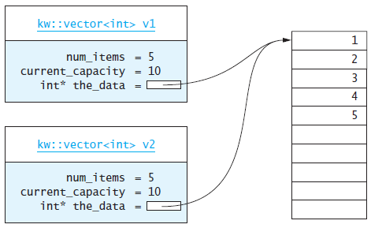
Shallow Copy versus Deep Copy
Referring back to our vector class, a copy of the size_t fields current_capacity and num_items creates independent copies of the variables
However, copy the pointer value the_data does not create an independent copy

Slide 66
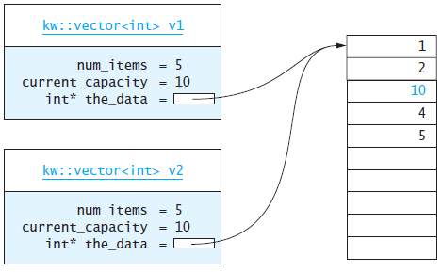
Shallow Copy versus Deep Copy (cont.)
Copying a pointer this way is considered a shallow copy
Because v1.the_data and v2.the_data point to the same object, the statement
v1[2] = 10;
also changes v2[2]

Slide 67
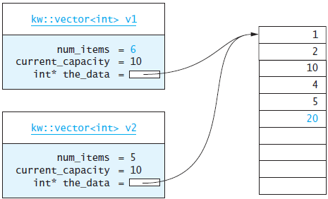
Shallow Copy versus Deep Copy (cont.)
Some changes to v1 will be reflected in v2, but others will not
The statement
v1.push_back(20);
will insert 20 into v1[5] and will change v1.num_items to 6, but will not change v2.num_items

Slide 68
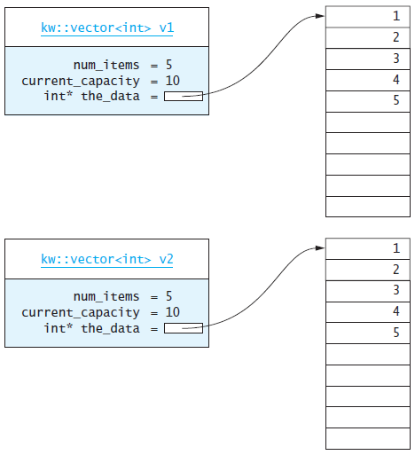
Shallow Copy versus Deep Copy (cont.)
We need to create an independent copy or a deep copy of the underlying array so that v1.the_data and v2.the_data point to different arrays, making vector v2 a deep copy of vector v1

Slide 69
Shallow Copy versus Deep Copy (cont.)
/** Make a copy of a vector.
@param other The vector to be copied
*/
vector<Item_Type>(const vector<Item_Type>& other) :
current_capacity(other.capacity), num_items(other.num_items),
the_data(new Item_Type[other.current_capacity]) {
for (size_t i = 0; i < num_items; i++)
the_data[i] = other.the_data[i];
}

Slide 70
Assignment Operator
Assignment should create an independent copy of an object
Assignment of primitive types is straightforward—the value is duplicated and placed in the target location (the variable on the left hand side of the assignment).
For class types, assignment is done by what is appropriately known as the assignment operator
If v1 and v2 are vector objects, the statement
v2 = v1;
is executed as if it were written
v2.operator=(v1);

Slide 71
Assignment Operator (cont.)
Every class has a default assignment operator which makes a copy of each data field of the source object (v1 above) and places it into the corresponding data field of the target object (v2 above)
If the data field is a class type, that class’s assignment operator is used
The default assignment operator makes a shallow copy of an object, so we must override it if we want truly independent copies

Slide 72
Assignment Operator (cont.)
/** Assign the contents of one vector to another.
@param other The vector to be assigned to this vector
@return This vector with a copy of the other vector's contents
*/
vector<Item_Type>& operator=(const vector<Item_Type>& other) {
// Make a copy of the other vector.
vector<Item_Type> the_copy(other);
// Swap contents of self with the copy.
swap(the_copy);
// Return -- upon return the copy will be destroyed.
return *this;
}

Slide 73
Assignment Operator (cont.)
Upon return, the destructor for the temporary object is invoked automatically by the compiler, deleting the old data

Slide 74
The Destructor
The purpose of the destructor is to undo what the constructor does
The constructor takes a block of uninitialized memory and sets it to a known state, thus creating an object
When the destructor is finished, the object is no longer considered to be in a valid state, and the memory it occupies can be reused for creating other objects
Unless this is done properly, the program will have memory leaks

Slide 75
The Destructor (cont.)
Each class has a default destructor, which effectively invokes the destructor for each data field
For primitive types, the destructor does nothing, and this is fine
However, a pointer is a primitive type that stores a memory address as its “value”
If a class contains a pointer, the default destructor does not do anything with it
If the pointer references a dynamically allocated object (such as the array referenced by pointer the_data), the memory allocated to that object must be freed
We need to provide a destructor that frees allocated memory when an object is destroyed

Slide 76
The Destructor (cont.)
The destructor for the vector class is defined as
~vector() {
delete[] the_data;
}
The symbol ~ indicates that a destructor is being defined
The destructor body releases the memory occupied by the dynamically allocated array

Slide 77
Single-Linked Lists and Double-Linked Lists
Section 4.5

Slide 78
Single-Linked Lists and Double-Linked Lists
A linked list is useful for inserting and removing at arbitrary locations
The vector is limited because its insert and erase methods operate in linear (O(n)) time —requiring a loop to shift elements
A linked list can add and remove elements at a known locations in O(1) time
A linked list is useful when you need to insert and remove elements frequently and at arbitrary locations

Slide 79
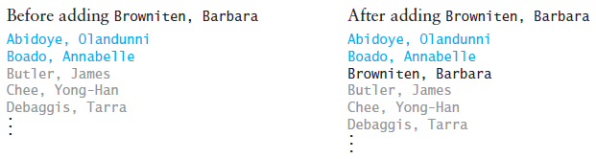
Single-Linked Lists and Double-Linked Lists (cont.)
When using a vector to maintain an alphabetized list of students at the beginning of a semester while students are adding and dropping courses, we would have to shift all names that follow the new person’s name down one position before you could insert a new student’s name

Slide 80
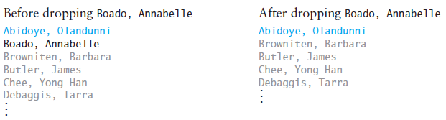
Single-Linked Lists and Double-Linked Lists (cont.)
If a student drops the course, the names of all students after the one who dropped would be shifted up one position to fill the gap

Slide 81
Single-Linked Lists and Double-Linked Lists (cont.)
To maintain a list of students who are waiting to register for a course, we could give each student a number, which is the student’s position in the line
If someone drops out of the line, everyone with a higher number gets a new number that is 1 lower than before
If someone cuts into the line because he or she “needs the course to graduate,” everyone after this person gets a new number that is 1 higher than before
The person maintaining the list is responsible for giving everyone his or her new number after a change

Slide 82
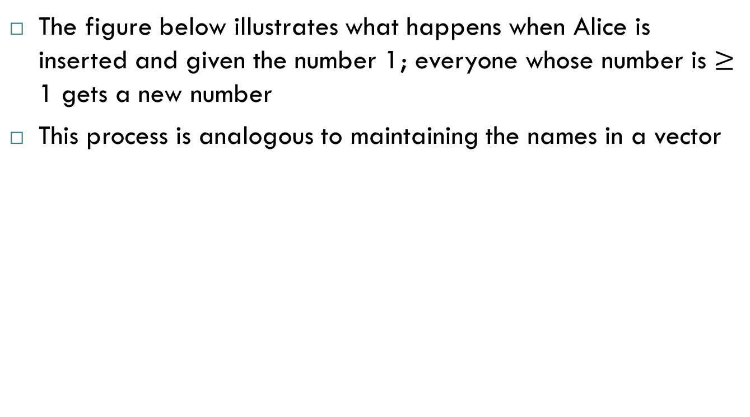
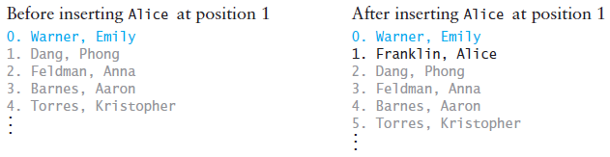
Single-Linked Lists and Double-Linked Lists (cont.)

Slide 83
Single-Linked Lists and Double-Linked Lists (cont.)
A better approach would be to give each person the name of the next person in line, instead of his or her own position in the line (which can change frequently)
To start the registration process, the person who is registering students calls the person who is at the head of the line
After he or she finishes registration, the person at the head of the line calls the next person, and so on
What if person A lets person B cut into the line before him? Because B has taken A’s position in line, A will register after B, so person B must have A’s name
Also, the person in front of the new person must know to call B instead of A

Slide 84
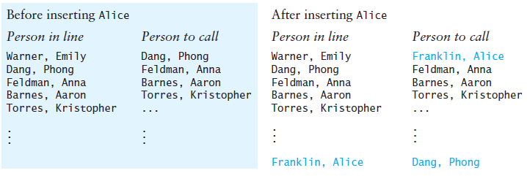
Single-Linked Lists and Double-Linked Lists (cont.)
The figure below illustrates what happens when Alice is inserted in the list
Only the two entries shown in color need to be changed (Emily must call Alice instead of Phong, and Alice must call Phong
Even though Alice is shown at the bottom, she is really the second student in the list

Slide 85
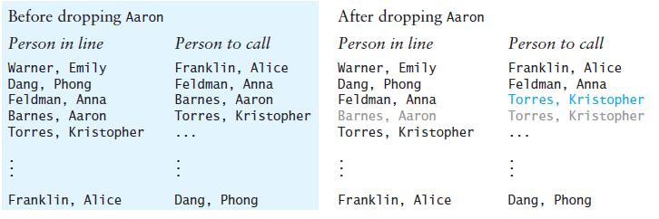
Single-Linked Lists and Double-Linked Lists (cont.)
What happens if someone drops out of our line?
In this case, the name of the person who follows the one that drops out must be given to the person who comes before the one who drops out
If Aaron drops out, only one entry needs to be changed (Anna must call Kristopher instead of Aaron)

Slide 86
Single-Linked Lists and Double-Linked Lists (cont.)
Using a linked list is analogous to the process just described
Insertion and removal are done in constant time, and no shifts are required
Each element in a linked list, called a node, stores information and a link to the next node in the list
"Warner, Emily" → "Franklin, Alice" → "Dang, Phong"

Slide 87
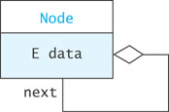
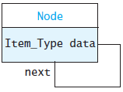
A List Node
A node can contain:
a data item
one or more links
A link is a pointer to a list node
In our structure, the node contains
A data field named data of type Item_Type
A pointer to the next node, named next

Slide 88
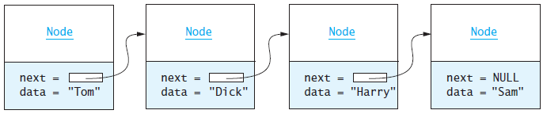
A List Node (cont.)

Slide 89
A List Node (cont.)
Node.h
#ifndef NODE_H_
#define NODE_H_
struct Node {
Item_Type data;
Node* next;
Node(const Item_Type& data_item, Node* next_ptr = NULL) :
data(data_item), next(next_ptr) {}
};
#endif
A struct is a data structure that contains data fields and possibly constructors. It is like a class, except that it has no operators

Slide 90
A List Node (cont.)
Node.h
#ifndef NODE_H_
#define NODE_H_
struct Node {
Item_Type data;
Node* next;
Node(const Item_Type& data_item, Node* next_ptr = NULL) :
data(data_item), next(next_ptr) {}
};
#endif
A Node is defined inside of a class, making it an inner class. The outer class is a template class that has the template parameter Item_Type

Slide 91
A List Node (cont.)
Node.h
#ifndef NODE_H_
#define NODE_H_
struct Node {
Item_Type data;
Node* next;
Node(const Item_Type& data_item, Node* next_ptr = NULL) :
data(data_item), next(next_ptr) {}
};
#endif
The Node is defined in the private part of the outer class, thus keeping the details private from the outer class’s clients. The reason for defining it as a struct is that a struct’s data members are public by default, thus accessible to the functions of the outer class

Slide 92
A List Node (cont.)
Node.h
#ifndef NODE_H_
#define NODE_H_
struct Node {
Item_Type data;
Node* next;
Node(const Item_Type& data_item, Node* next_ptr = NULL) :
data(data_item), next(next_ptr) {}
};
#endif
The constructor initializes the values of data and next. We provide NULL as a default value for next

Slide 93
Connecting Nodes (cont.)
We can construct this list using the following sequence of statements:
Node* tom = new Node("Tom");
Node* dick = new Node("Dick");
Node* harry = new Node("Harry");
Node* sam = new Node("Sam");
tom->next = dick;
dick->next = harry;
harry->next = sam;

Slide 94
Connecting Nodes (cont.)
We can construct the list above using the following sequence of statements:
Node* tom = new Node("Tom");
Node* dick = new Node("Dick");
Node* harry = new Node("Harry");
Node* sam = new Node("Sam");
tom->next = dick;
dick->next = harry;
harry->next = sam;
This statement stores a pointer (link) to the node with data "Dick" in the data field next of the node pointed to by tom

Slide 95
Connecting Nodes (cont.)
Generally we do not have individual pointers to each of the nodes
Instead, we have a pointer to the first node in the list and work from there
Thus we could build the list above as follows:
Node* head = new Node("Tom");
head->next = new Node("Dick");
head->next->next = new Node("Harry");
head->next->next->next = new Node("Sam");

Slide 96
Connecting Nodes (cont.)
On the previous slide, we grew the list by adding each new node to the end of the list so far. We can also grow a list by adding nodes to the front of the list
Node* head = new Node("Sam");
head = new Node("Harry", head);
head = new Node("Dick", head);
head = new Node("Tom", head);

Slide 97
Connecting Nodes (cont.)
[insert Figure 4.16 here]
In the previous slide, we grew the list by adding each new node to the end of the list so far. We can also grow a list by adding nodes to the front of the list
Node* head = new Node("Sam");
head = new Node("Harry", head);
head = new Node("Dick", head);
head = new Node("Tom", head);
Each of these statements creates a new node, whose data component is a_name and whose next component is the list so far. Then head is reset to point to this new node. This has the effect of adding the new node to the front of the existing list

Slide 98
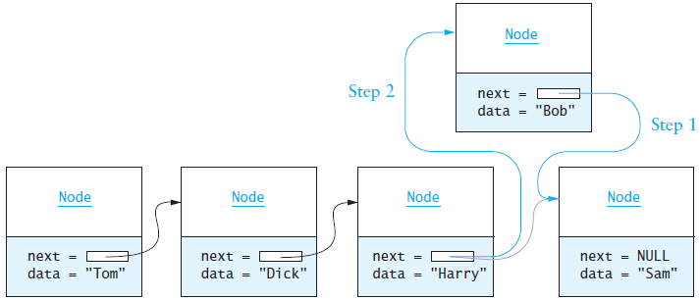
Inserting a Node in a List
Node* bob = new Node("Bob");
bob->next = harry->next; // Step 1
harry->next = bob; // Step 2

Slide 99
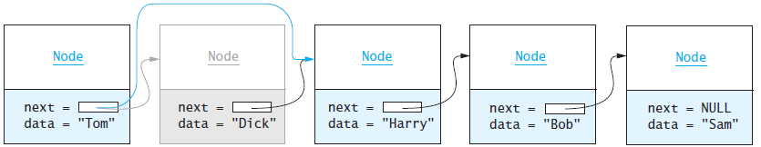
Removing a Node
Node* ptr = tom->next; // Pointer to Node to be deleted
tom->next = tom->next->next; // Remove Node from list
delete ptr; // Delete Node to free storage

Slide 100
Removing a Node (cont.)
Node* ptr = tom->next; // Pointer to Node to be deleted
tom->next = tom->next->next; // Remove Node from list
delete ptr; // Delete Node to free storage
[Insert figure 4.18 here]
Note this statement used to release the memory allocated to the node we removed. We do this to avoid memory leaks

Slide 101
Traversing a Linked List
Traversing a linked list is a fairly simple process:
Set node_ptr to point to the first node
while node_ptr is not NULL
Do something with node pointed to by node_ptr
Set node_ptr to node_ptr->next

Slide 102
Traversing a Linked List (cont.)
node_ptr = tom; // tom points to the first node
while (node_ptr != NULL) {
cout << node_ptr->data;
if (node_ptr->next != NULL) {
cout << " ==> ";
}
node_ptr = node_ptr->next;
}
cout << endl;
Traversing the list on the previous slide produces:
Tom ==> Harry ==> Bob ==> Sam

Slide 103
Double-Linked Lists
Limitations of a singly-linked list include:
Insertion at the front is O(1); insertion at other positions is O(n)
Insertion is convenient only after a referenced node
Removing a node requires a reference to the previous node
We can traverse the list only in the forward direction
We can overcome these limitations:
Add a reference in each node to the previous node, creating a double-linked list

Slide 104
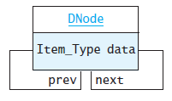
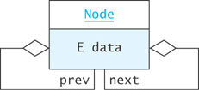
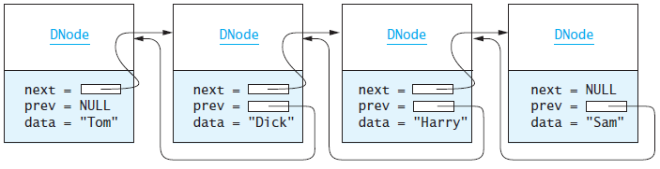
Double-Linked Lists (cont.)

Slide 105
The DNode Class
DNode.h
#ifndef DNODE_H_
#define DNODE_H_
struct DNode {
Item_Type data;
DNode* next;
DNode* prev;
DNode(const Item_Type& the_data,
DNode* prev_val = NULL, DNode* next_val = NULL) :
data(the_data), next(next_val), prev(prev_val) {}
};
#endif

Slide 106
Inserting into a Double-Linked List
from predecessor
sam
Node
Node
next =
= prev
data = "Harry"
next = null
= prev
data = "Sam"
to predecessor
Dnode* sharon = new DNode("Sharon");
sharon->next = sam;
sharon->prev = sam->prev;
sam->prev->next = sharon;
sam->prev = sharon
sharon
Node
next =
= prev
data = "Sharon"

Slide 107
Removing from a Double-Linked List
harry
Node
Node
next =
= prev
data = "Sharon"
next =
= prev
data = "Dick"
harry->prev->next = harry->next;
harry->next->prev = harry->prev;
delete harry;
Node
next =
= prev
data = "Harry"

Slide 108
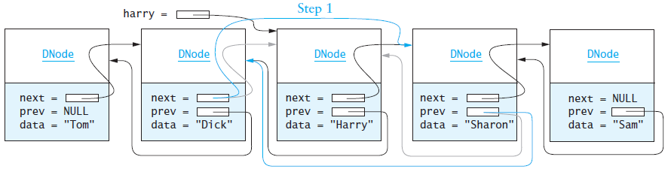
Removing from a Double-Linked List (cont.)
After removing harry from the double-linked list

Slide 109
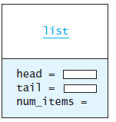

Creating a Double-Linked List Object
So far we have worked only with internal DNodes for a linked list
A double-linked list object has data fields:
head (a pointer to the first list DNode)
tail (a pointer to the last list DNode)
num_items (the number of internal DNodes)

Slide 110
Circular Lists
Circular double-linked list:
Link last node to the first node, and
Link first node to the last node
head->prev = tail;
tail->next = head;
We can also build single-linked circular lists:
Traverse in forward direction only
If we keep a pointer to tail, we can access the last element and the first element in O(1) time
Advantages:
Continue to traverse even after passing the first or last node
Visit all elements from any starting point
Never fall off the end of a list
Disadvantage: The code must avoid an infinite loop!

Slide 111
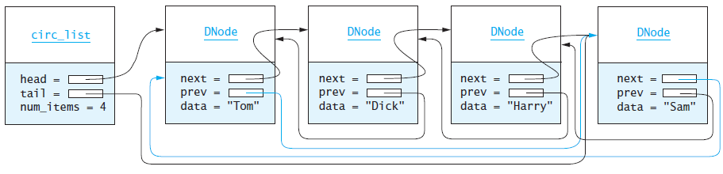
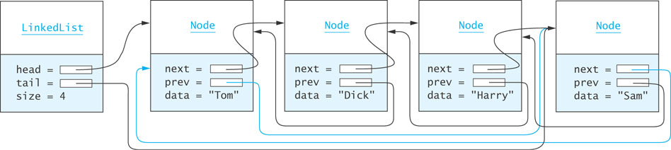
Circular Lists (cont.)

Slide 112
The list Class and the Iterator
Section 4.6

Slide 113
The list Class
The list class is part of the C++ standard library defined in header <list>
It implements a double-linked list
The following slide presents a subset of its functions

Slide 114
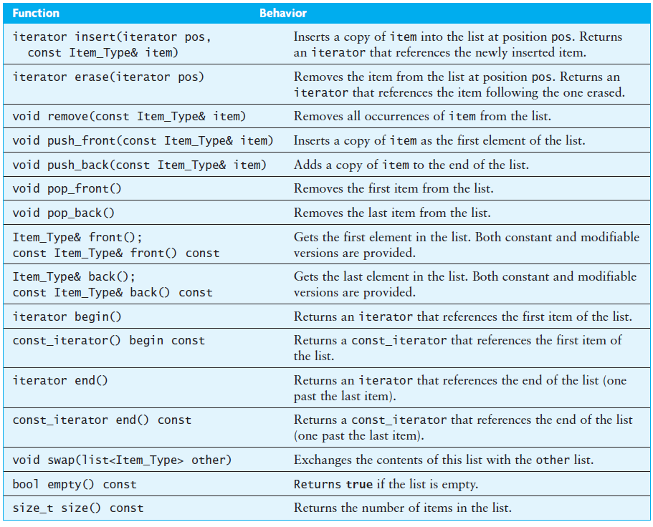
The list Class (cont.)

Slide 115
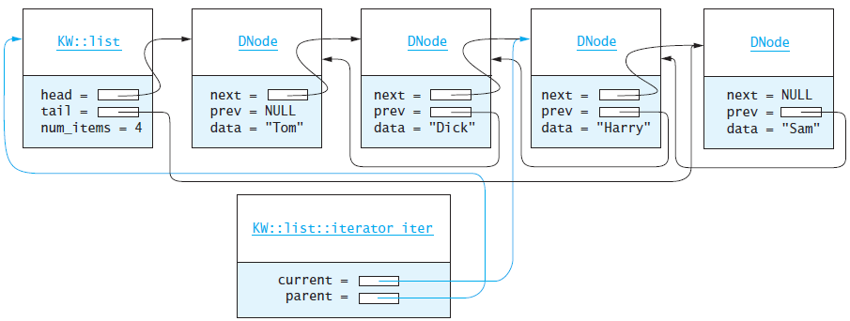
The Iterator
The subscripting operator (operator[]) is not defined for the list class
Instead, an iterator can be serve as a moving place marker that keeps track of the current position in a particular linked list
An iterator can be advanced forward using operator++ or advanced backward using operator--

Slide 116
The Iterator (cont.)
We use an iterator like a pointer
The pointer dereferencing operator (operator*) returns a reference to the field data in the DNode object at the current iterator position
The list table (shown on a previous slide and shown again on the next slide) has four functions that manipulate iterators
Function insert adds a list element at the position indicated by iterator
Function erase removes a list element at the position indicated by iterator
Function begin returns an iterator positioned at the first element
Function end returns an iterator positioned just before the last element

Slide 117
The Iterator (cont.)

Slide 118
The Iterator (cont.)
Using an iterator preserves information hiding: the internal structure of the DNode is not visible to clients
Clients can access or modify the data and can move from one DNode in the list to another, but they cannot modify the structure of the linked list, since they have no direct access to the prev or next data fields

Slide 119
The Iterator (cont.)
Assume iter is declared as an iterator object for list a_list. We can use the following fragment to process each element in a_list instead of the one shown at the beginning of this section
// Access each list element and process it.
for (list<Item_Type>::iterator iter = a_list.begin();
iter != a_list.end(); ++iter) {
// Do something with the next element (*iter)
Item_Type next_element = *iter;
...
}

Slide 120
The Iterator (cont.)
Assume iter is declared as an iterator object for list a_list. We can use the following fragment to process each element in a_list instead of the one shown at the beginning of this section
// Access each list element and process it.
for (list<Item_Type>::iterator iter = a_list.begin();
iter != a_list.end(); ++iter) {
// Do something with the next element (*iter)
Item_Type next_element = *iter;
...
}
The initialization parameter declares and initializes an iterator object of type list<Item_Type>::iterator

Slide 121
The Iterator (cont.)
Assume iter is declared as an iterator object for list a_list. We can use the following fragment to process each element in a_list instead of the one shown at the beginning of this section
// Access each list element and process it.
for (list<Item_Type>::iterator iter = a_list.begin();
iter != a_list.end(); ++iter) {
// Do something with the next element (*iter)
Item_Type next_element = *iter;
...
}
Initially this iterator is set to point to the first list element, which is returned by a_list.begin()

Slide 122
The Iterator (cont.)
Assume iter is declared as an iterator object for list a_list. We can use the following fragment to process each element in a_list instead of the one shown at the beginning of this section
// Access each list element and process it.
for (list<Item_Type>::iterator iter = a_list.begin();
iter != a_list.end(); ++iter) {
// Do something with the next element (*iter)
Item_Type next_element = *iter;
...
}
The test parameter causes loop exit when the iterator has passed the last list element

Slide 123
The Iterator (cont.)
Assume iter is declared as an iterator object for list a_list. We can use the following fragment to process each element in a_list instead of the one shown at the beginning of this section
// Access each list element and process it.
for (list<Item_Type>::iterator iter = a_list.begin();
iter != a_list.end(); ++iter) {
// Do something with the next element (*iter)
Item_Type next_element = *iter;
...
}
The update parameter advances the iterator to its next position in the list

Slide 124
The Iterator (cont.)
An iterator is a generalization of a pointer
The following for statement accesses each element in the array declared as int an_array[SIZE]
for (int* next = an_array; next != an_array + SIZE; ++next) {
// Do something with the next element (*next)
int next_element = *next;
...
}
The for statements just discussed have a form different from what we are used to….

Slide 125
Testing for More List Nodes
To test for more nodes in a list, compare the current iterator position (iter) with a_list.end(), the iterator position just beyond the end of the list
iter != a_list.end()
Use prefix increment (++iter) rather than postfix increment, for more efficient code

Slide 126
Common Requirements for Iterators
Each container in the Standard Template Library (STL) must provide both an iterator and a const_iterator type
The only difference between the iterator and the const_iterator is the return type of the pointer dereferencing operator (operator*)
The iterator returns a reference
The const_iterator returns a const reference

Slide 127
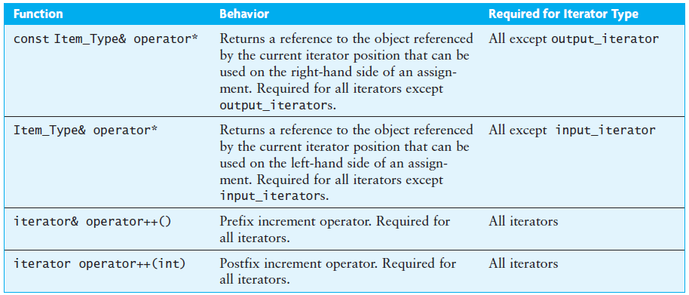
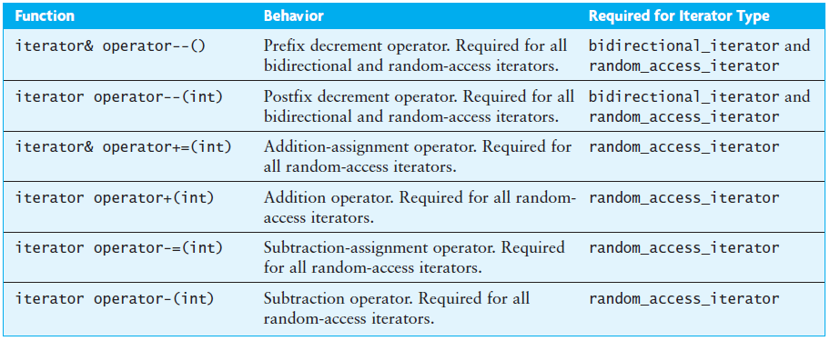
Common Requirements for Iterators (cont.)

Slide 128
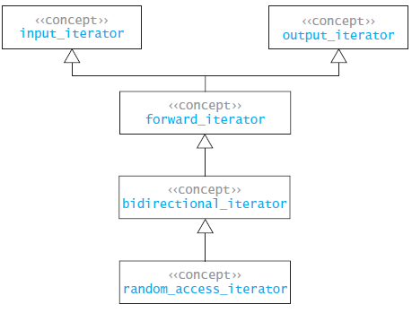
Common Requirements for Iterators (cont.)
In the following UML diagram, each of the iterator types represents what is called a concept
A concept represents a common interface that a generic class must meet

Slide 129
Removing Elements from a List
You can use an iterator to remove an element from a list as you access it
You use the iterator that refers to the item you want to remove as an argument to the list<Item_Type>.erase function
The erase function returns an iterator that refers to the item after the one removed
You use this returned value to continue traversing the list
You should not attempt to increment the iterator that was used in the call to erase, since it no longer refers to a valid list DNode

Slide 130
Removing Elements from a List (cont.)
Assume a list of int values. To remove all elements that are divisible by a particular value:
void remove_divisible_by(list<int>& a_list, int div) {
list<int>::iterator iter = a_list.begin();
while (iter != a_list.end()) {
if (*iter % div == 0) {
iter = a_list.erase(iter);
} else {
++iter;
}
}
}

Slide 131
Removing Elements from a List (cont.)
Assume a list of int values. To remove all elements that are divisible by a particular value:
void remove_divisible_by(list<int>& a_list, int div) {
list<int>::iterator iter = a_list.begin();
while (iter != a_list.end()) {
if (*iter % div == 0) {
iter = a_list.erase(iter);
} else {
++iter;
}
}
}
The expression *iter has the value of the current int value referenced by the iterator

Slide 132
Removing Elements from a List (cont.)
Assume a list of int values. To remove all elements that are divisible by a particular value:
void remove_divisible_by(list<int>& a_list, int div) {
list<int>::iterator iter = a_list.begin();
while (iter != a_list.end()) {
if (*iter % div == 0) {
iter = a_list.erase(iter);
} else {
++iter;
}
}
}
The function call in this statement removes the element referenced by iter and then returns an iterator that references the next element

Slide 133
Removing Elements from a List (cont.)
Assume a list of int values. To remove all elements that are divisible by a particular value:
void remove_divisible_by(list<int>& a_list, int div) {
list<int>::iterator iter = a_list.begin();
while (iter != a_list.end()) {
if (*iter % div == 0) {
iter = a_list.erase(iter);
} else {
++iter;
}
}
}
We use the prefix increment operator because we do not need a copy of the iterator prior to incrementing it

Slide 134
Removing Elements from a List (cont.)
Assume that we have a list of string values. To locate the first occurrence of a string target and replace it with the string new_value:
void find_and_replace(list<string>& a_list,
const string& target,
const string& new_value) {
list<string>::iterator iter = a_list.begin();
while (iter != a_list.end()) {
if (*iter == target) {
*iter = new_value;
break; // Exit the loop.
}
else {
++iter;
}
}
}

Slide 135
Implementation of a Double-Linked List Class
Section 4.7

Slide 136
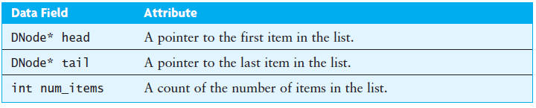
Implementation of a Double-Linked List Class
We will implement a simplified version of the list class, KW::list
The KW::list class is for demonstration purposes only; in your programs you should use the standard list class provided in the C++ standard library in header <list>

Slide 137
Implementing the KW::list Functions
namespace KW {
template<typename Item_Type>
class list {
private:
#include "DNode.h“
public:
#include "list_iterator.h"
friend class iterator;
#include "list_const_iterator.h"
friend class const_iterator;
private:
DNode* head;
DNode* tail;
int num_items;

Slide 138
Implementing the KW::list Functions (cont.)
namespace KW {
template<typename Item_Type>
class list {
private:
#include "DNode.h“
public:
#include "list_iterator.h"
friend class iterator;
#include "list_const_iterator.h"
friend class const_iterator;
private:
DNode* head;
DNode* tail;
int num_items;
The DNode is private…

Slide 139
Implementing the KW::list Functions (cont.)
namespace KW {
template<typename Item_Type>
class list {
private:
#include "DNode.h“
public:
#include "list_iterator.h"
friend class iterator;
#include "list_const_iterator.h"
friend class const_iterator;
private:
DNode* head;
DNode* tail;
int num_items;
but the iterator is public

Slide 140
Implementing the KW::list Functions (cont.)
namespace KW {
template<typename Item_Type>
class list {
private:
#include "DNode.h“
public:
#include "list_iterator.h"
friend class iterator;
#include "list_const_iterator.h"
friend class const_iterator;
private:
DNode* head;
DNode* tail;
int num_items;
We declare these objects as friends because both need to access and modify the private members of the list class.

Slide 141
The Default Constructor
/** Construct an empty list. */
list() {
head = NULL;
tail = NULL;
num_items = 0;
}

Slide 142
The Copy Constructor
/** Construct a copy of a list. */
list(const list<Item_Type>& other) {
head = NULL;
tail = NULL;
num_items = 0;
for (const_iterator itr = other.begin();
itr != other.end(); ++itr) {
push_back(*itr);
}
}

Slide 143
The Destructor
/** Destroy a list. */
~list() {
while (head != NULL) {
DNode* current = head;
head = head->next;
delete current;
}
tail = NULL;
num_items = 0;
}

Slide 144
The Assignment Operator
/** Assign the contents of one list to another. */
list<Item_Type>& operator=(const list<Item_Type>& other) {
// Make a copy of the other list.
list<Item_Type> temp_copy(other);
// Swap contents of self with the copy.
swap(temp_copy);
// Return -- upon return the copy will be destroyed.
return *this;
}

Slide 145
The push_front Function
DNode
DNode
DNode
next =
null = prev
data = "Tom"
next =
= prev
data = "Harry"
next = NULL
= prev
data = "Sam"
KW:list
head = null
tail = null
num_items = 3
4
void push_front(const Item_Type& item) {
head = new DNode(item, NULL, head);
if (head->next != NULL)
head->next->prev = head;
if (tail == NULL)
tail = head;
num_items++;
}
DNode
next =
null = prev
data = "Ann"

Slide 146
The push_back Function
DNode
DNode
DNode
next =
prev = NULL
data = "Tom"
next =
= prev
data = “Ann"
next = NULL
= prev
data = "Sam"
KW::list
head = null
tail = null
size = 3
4
void push_back(const Item_Type& item) {
if (tail != NULL) {
tail->next = new DNode(item, tail, NULL);
tail = tail->next;
num_items++
} else { // List was empty.
push_front(item);
}
}
Node
next = NULL
= prev
data = “Zoe"

Slide 147
The insert Function
iterator insert(iterator pos, const Item_Type& item) {
// Check for special cases
if (pos.current == head) {
push_front(item);
return begin();
} else if (pos.current == NULL) { // Past the last node.
push_back(item);
return iterator(this, tail);
}
. . .
(non-special cases continued on next slide...)

Slide 148
The insert Function (cont.)
KW:list::iterator iter
current = parent =
DNode
DNode
DNode
next =
prev = NULL
data = "Tom"
next =
= prev
data = "Ann"
next = NULL
= prev
data = "Sam"
KW::list
head = null
tail = null
num_items = 3
4
DNode* new_node = new DNode(item,
pos.current->prev,
pos.current);
pos.current->prev->next = new_node;
pos.current->prev = new_node;
num_items++;
return iterator(this, new_node);
}
DNode
next =
= prev
data = “Sharon"
new_node

Slide 149
The pop_front Function
void pop_front() {
if (head == NULL)
throw std::invalid_argument
("Attempt to call pop_front() on an empty list");
DNode* removed_node = head;
head = head->next;
delete removed_node;
if (head != NULL)
head->prev = NULL;
else
tail = NULL;
num_items--;
}

Slide 150
The pop_back Function
void pop_back() {
if (tail == NULL)
throw std::invalid_argument
("Attempt to call pop_back() on an empty list");
DNode* removed_node = tail;
tail = tail->prev;
delete removed_node;
if (tail != NULL)
tail->next = NULL;
else
head = NULL;
num_items--;
}

Slide 151
The erase Function
iterator erase(iterator pos) {
if (empty())
throw std::invalid_argument ("Attempt to call erase on an empty list");
if (pos == end())
throw std::invalid_argument ("Attempt to call erase of end()");
iterator return_value = pos;
++return_value;
if (pos.current == head) {
pop_front();
return return_value;
} else if (pos.current == tail) {
pop_back();
return return_value;
} else {
DNode* removed_node = pos.current;
removed_node->prev->next = removed_node->next;
removed_node->next->prev = removed_node->prev;
delete removed_node;
return return_value;
}
}

Slide 152
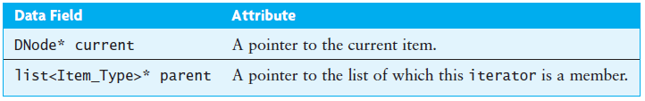
Implementing the iterator

Slide 153
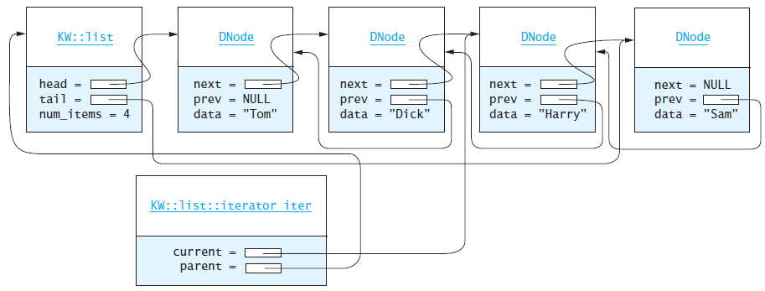
Implementing the iterator (cont.)
We can change "Harry" to "Henry" by the statement
*iter = "Henry";
The expression *--iter (equivalent to *(--iter)) would move the iterator backward and return a reference to its new position

Slide 154
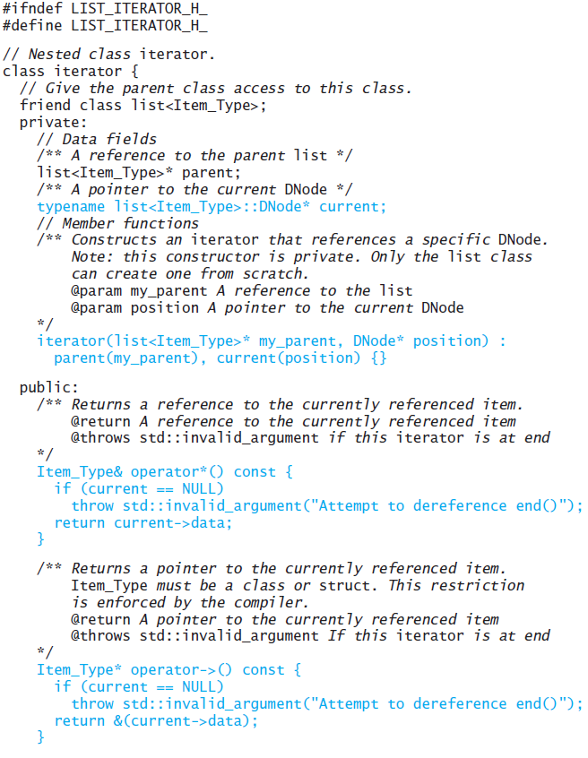
Declaring the Class iterator
The Nested Class iterator (with functions explored subsequently)

Slide 155
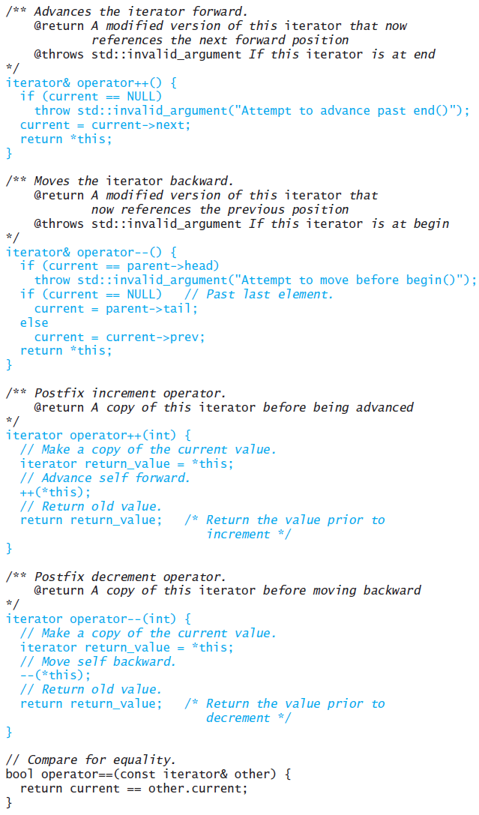
Declaring the Class iterator (cont.)

Slide 156
The Constructor
The KW::list::iterator constructor takes as a parameter a pointer to the DNode at which the iteration is to begin
This constructor is defined in the private part so that clients cannot create arbitrary iterators
The KW::list class creates and returns iterator objects as needed (we declared the KW::list a friend of the KW::list::iterator class)
iterator(list<Item_Type>* my_parent, DNode* position) :
parent(my_parent), current(position) {}

Slide 157
The Dereferencing Operator
The dereferencing operator (operator*) verifies that the current pointer is valid and then returns a reference to the data field in the DNode that it points to:
Item_Type& operator*() const {
if (current == NULL)
throw std::invalid_argument
("Attempt to dereference end()");
return current->data;
}

Slide 158
Member Access Operator
Since iterators can be used like pointers, the member access operator (operator->) is also defined
Item_Type* operator->() const {
if (current == NULL)
throw std::invalid_argument
("Attempt to dereference end()");
return &(current->data);
}

Slide 159
The Prefix Increment and Decrement Operators
iterator& operator++() {
if (current == NULL)
throw std::invalid_argument("Attempt to advance past end()");
current = current->next;
return *this;
}
iterator& operator--() {
if (current == parent->head)
throw std::invalid_argument("Attempt to move before begin()");
if (current == NULL) // Past last element.
current = parent->tail;
else
current = current->prev;
return *this;
}

Slide 160
The Postfix Increment and Decrement Operators
iterator operator++(int) {
// Make a copy of the current value.
iterator return_value = *this;
// Advance self forward.
++(*this);
// Return old value.
return return_value; /* Return the value prior to increment */
}
iterator operator--(int) {
// Make a copy of the current value.
iterator return_value = *this;
// Move self backward.
--(*this);
// Return old value.
return return_value; /* Return the value prior to decrement */
}

Slide 161
The const_iterator
The const_iterator is identical to the iterator, with two exceptions:
The dereferencing operator returns a const reference
The member access operator returns a const pointer
The const in the operator heading means that the referenced item cannot be changed
The compiler ensures that any attempt to do so results in an error
The complete code for class const_iterator is available on the text’s website
The member functions and data members are identical to those for class iterator except for the two functions shown on the following slides

Slide 162
The const_iterator (cont.)
/** Return a reference to the currently referenced item.
@return A reference to the currently referenced item
@throws std::invalid_argument If this const_iterator
is at end
*/
const Item_Type& operator*() const {
if (current == NULL)
throw std::invalid_argument
("Attempt to dereference end()");
return current->data;
}

Slide 163
The const_iterator (cont.)
/** Return a pointer to the currently referenced item.
Item_Type must be a class or struct. This restriction
is enforced by the compiler.
@return A pointer to the currently referenced item
@throws std::invalid_argument If this const_iterator
is at end
*/
const Item_Type* operator->() const {
if (current == NULL)
throw std::invalid_argument
("Attempt to dereference end()");
return &(current->data);
}

Slide 164
The const_iterator (cont.)
You need to use the const_iterator when a list is passed as a const
For example, the following function prints the contents of a list of ints:
void print_list(const list<int>& a_list) {
list<int>::const_iterator iter = a_list.begin();
while (iter != a_list.end()) {
cout << *iter;
++iter;
if (iter != a_list.end())
cout << " ==> ";
}
cout << '\n';
}

Slide 165
Application of the list Class
Section 4.8

Slide 166
Application of the list Class
Problem
We want to maintain this list so that it will be in alphabetical order even after students have added and dropped the course
Analysis
Develop a general Ordered_List class that can be used to store any group of objects that can be compared using the less-than operator
Either
extend the C++ list class to create a new class Ordered_List
or create an Ordered_List class that uses a list to store the items
If we implement our Ordered_List class as an extension of list, a client will be able to use functions in the list class that can insert new elements or modify existing elements in such a way that the items are no longer in order
Therefore, we will use a list as a component of the Ordered_List

Slide 167
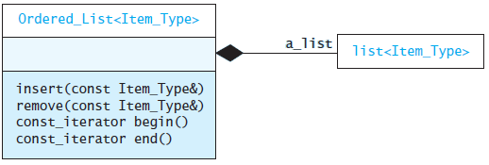
Application of the list Class (cont.)
We do not provide an iterator class, because it could be used to change the values in the list in such a way that order is no longer preserved
Because the list’s erase function takes an iterator parameter and not a const_iterator, and because there is no efficient way to convert from a const_iterator to an iterator, we will not implement the erase function for the Ordered_List, even though erasing an element does not violate the ordering of the other elements

Slide 168
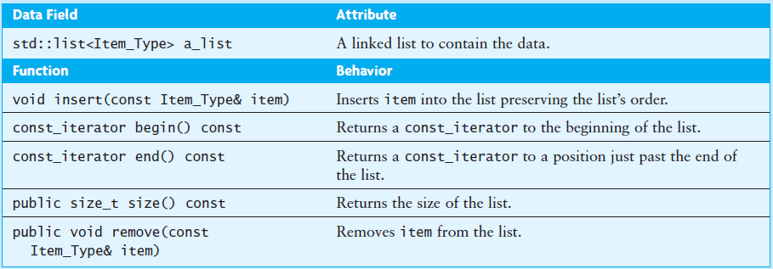
Application of the list Class (cont.)

Slide 169
Implementation
Defining the const_iterator type
typedef typename std::list<Item_Type>::const_iterator
const_iterator;

Slide 170
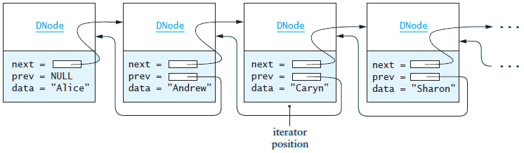
Implementation (cont.)
The insert function

Slide 171
Implementation (cont.)
Algorithm for Insertion
1. Find the first item in the list that is greater than or equal to the item to be inserted
2. Insert the new item before this one
We can refine this algorithm as follows:
1.1 Create an iterator that starts at the beginning of the list
1.2 while the iterator is not at the end and the item at the iterator position is less than the item to be inserted
1.3 Advance the iterator
2. Insert the new item before the current iterator position

Slide 172
Implementation (cont.)
Code for Insertion
void insert(const Item_Type& an_item) {
typename std::list<Item_Type>::iterator itr = a_list.begin();
while (itr != a_list.end() && *itr < an_item)
++itr;
// itr points to the first item >= an_item or the end.
a_list.insert(itr, an_item);
}

Slide 173
Implementation (cont.)
Using Delegation for the Other Functions
The remaining functions in are implemented via delegation to the list class
They merely call the corresponding function in the list
For example, the remove function is coded as follows:
void remove(const Item_Type& item) {
a_list.remove(item);
}
We define the begin function as follows:
const_iterator begin() const {
return a_list.begin();
}

Slide 174
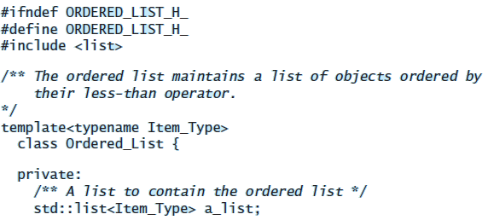
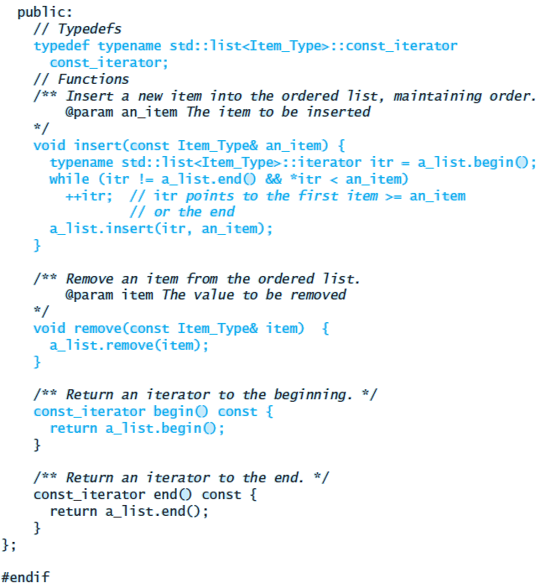
Implementation (cont.)

Slide 175
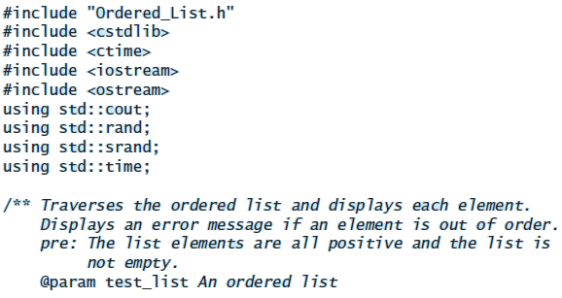
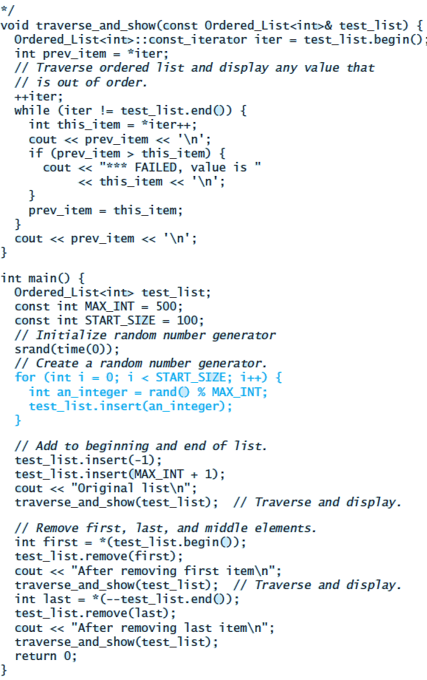
Testing

Slide 176
Standard Library Containers
Section 4.9

Slide 177
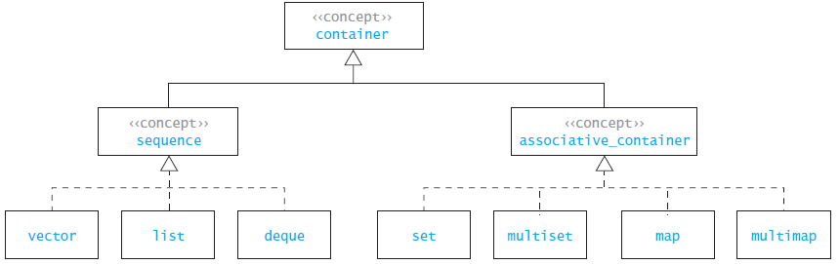
Standard Library Containers
The vector and the list are examples of what the C++ standard calls a sequential container; you may have observed that the interfaces are similar
The C++ standard uses the term container to represent a class that can contain objects
C++ defines a common interface for all containers and then splits the set of containers into sequential containers and associative containers
Common requirements unique to these subsets are also defined and the individual containers have their own additional requirements

Slide 178
Standard Library Containers (cont.)
This is not an inheritance hierarchy
The term concept is used to represent the set of common requirements for the container, sequence, or associative_container
Although a list and a vector may have several member functions in common, they may not be used polymorphically
However, both vectors and lists, as well as other sequences, can be used interchangeably by generic algorithms

Slide 179
Standard Library Containers (cont.)
The basic difference between a sequence and an associative container is that items in a sequence (for example, a vector or a list) follow some linear arrangement
At any given time each element has a particular position relative to the other items in the container
In an associative container, on the other hand, there is no particular position for each item in the container
Items are accessed by value, rather than their position

Slide 180
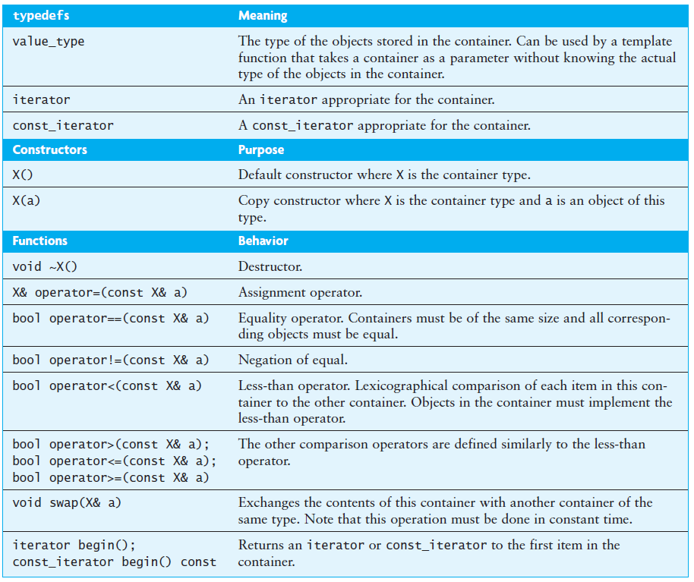
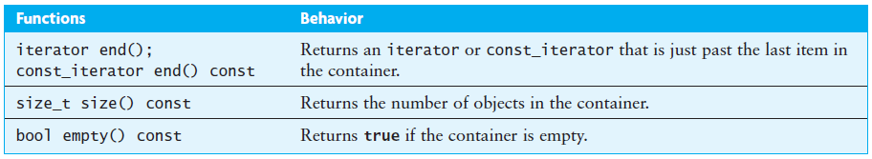
Common Features of Containers

Slide 181
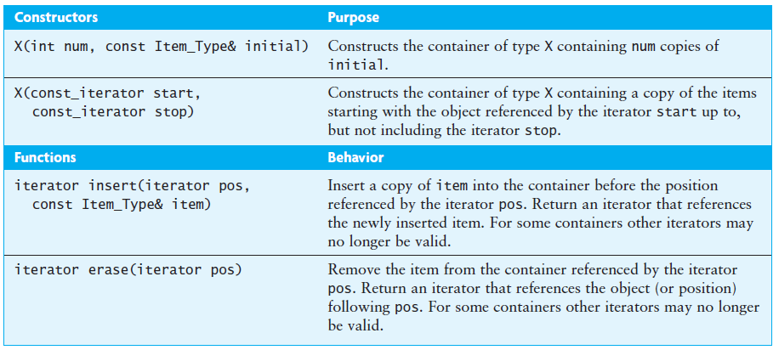
Sequences

Slide 182
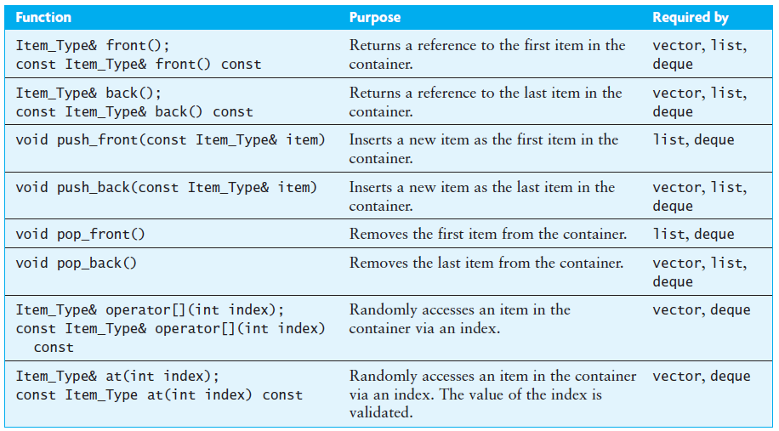
Optional Requirements for Sequences

Slide 183
Optional Requirements for Sequences (cont.)
You may wonder why the Standard does not require all of these functions for all sequences
The authors of the Standard chose to require only those functions that could be implemented in constant time, or at least amortized constant time
Thus push_back is required for all sequences, but push_front is not required for the vector, where it would be O(n) because all elements currently in the vector would have to be shifted
Likewise, the subscripting operator is not required for the list because it needs to traverse the list starting at the beginning

Slide 184
Associative Containers
The associative containers are designed for fast retrieval of data based on a unique value stored in each item, called its key
There are four associative containers:
set
multiset
map
multimap
The set and multiset store only keys, while the map and multimap associate a key with a value
We discuss these containers in more detail in Chapter 9

Slide 185
Vector Implementation Revisited
The KW::vector class we described in Section 4.3 does not meet the requirements for a sequential container exactly
The insert and erase functions were defined in terms of an index rather than an iterator
We also did not implement the functions begin and end
It is relatively easy to modify our KW::vector class so that it meets the requirements

Slide 186
The vector::iterator
The simplest approach to defining the iterator and const_iterator for the vector is to define them to be equivalent to pointers
typedef Item_Type* iterator;
typedef const Item_Type* const_iterator;
The vector functions begin and end are then implemented as follows:
iterator begin() { return the_data; }
iterator end() { return the_data + num_items; }

Slide 187
The vector::iterator (cont.)
The vector contents are stored in array the_data, so the_data is the address of the first element of this array and the_data + num_items is the address just past the last element
This is the approach taken in many implementations of the standard, and is perfectly legal
A better approach is to define an iterator class that held both a pointer to an item and a pointer to the parent vector
The operators * and -> then can validate the pointers before dereferencing them
Since this is a random access iterator, the addition and subtraction operations also must be defined

Slide 188
The vector::iterator (cont.)
The following function uses the iterator (parameter pos) rather than the index:
iterator insert(iterator pos, const Item_Type& the_value) {
if ((pos - begin()) < 0 || (end() - pos) < 0) {
throw std::out_of_range
("position to insert is out of range");
}
if (num_items == current_capacity) {
reserve(2 * current_capacity);
}
for (iterator p = end(); p > pos; p--) {
*p = *(p - 1);
}
*pos = the_value;
num_items++;
}

Slide 189
The vector::iterator (cont.)
The following uses the iterator (parameter pos) rather than the index:
iterator insert(iterator pos, const Item_Type& the_value) {
if ((pos - begin()) < 0 || (end() - pos) < 0) {
throw std::out_of_range
("position to insert is out of range");
}
if (num_items == current_capacity) {
reserve(2 * current_capacity);
}
for (iterator p = end(); p > pos; p--) {
*p = *(p - 1);
}
*pos = the_value;
num_items++;
}
This code is equivalent to the version given previously if you substitute:
begin() + index for pos, and
end() - begin() for num_items

Slide 190
Standard Library Algorithms and Function Objects
Section 4.10

Slide 191
The find Function
To find an int value in a list we could write the following:
list<int>::iterator find(list<int>& a_list, int target) {
for (list<int>::iterator itr = a_list.begin();
itr != a_list.end(); ++itr) {
if (*itr == target)
return itr;
}
return a_list.end();
}

Slide 192
The find Function (cont.)
If we want to find a string instead of an int, we could rewrite the function
Rather than writing different copies of a function to work with different types, C++ allows us to define template functions
Template functions are like template classes in that we can define template parameters that are replaced with actual parameters at compile time

Slide 193
The find Function (cont.)
template<typename Item_Type>
std::list<Item_Type>::iterator
find(std::list<Item_Type>& a_list,
const Item_Type& target) {
typedef typename std::list<Item_Type>::iterator iterator;
for (iterator itr = a_list.begin();
itr != a_list.end(); ++itr) {
if (*itr == target)
return itr;
}
return a_list.end();
}

Slide 194
The find Function (cont.)
What if we want to search a vector instead of a list?
Because the search loop is controlled by an iterator, the inventors of the STL chose to add an iterator to the container to be searched as a template parameter as well as the element data type
The STL template function find is effectively defined as follows:
template<typename Iterator, typename Item_Type>
Iterator find(Iterator first, Iterator last,
const Item_Type& target) {
while (first != last) {
if (*first == target)
return first;
++first;
}
return first;
}

Slide 195
The find Function (cont.)
In function find, the iterator parameter first points to the first element in the container; the parameter last points just past the last element in the container
The actual types of the iterators and the target are determined at compile time
If list_1 and vec_1 are a list<int> and a vector<string>, we can search these containers using the following function calls:
if (find(list_1.begin(), list_1.end(), 10) != list_1.end())
cout << "list 1 contains 10\n";
else
cout << "list 1 does not contain 10\n";
if (find(vec_1.begin(), vec_1.end(), "abc") != vec_1.end())
cout << "vec_1 contains \"abc\"\n";
else
cout << "vec_1 does not contain \"abc\"\n";

Slide 196
The find Function (cont.)
The actual types of the arguments to find do not have to be iterators defined by a container
Since an iterator is a generalization of a pointer, pointers can be used as well
We can call find by passing pointers to the beginning and end of an array
In the following if statement, the pointer list_data points to the first element of the array and list_data + 7 points to the element just past the end of the array
int list_data = {1, 4, 3, 5, 10, 8, 9};
...
if (find(list_data, list_data + 7, 10) != list_data + 7) ...

Slide 197
The Algorithm Library
The standard library contains several template functions defined in the header <algorithm>
Like find, many of them work on a pair of iterators that defines the sequence of input values
Some of them also take function objects as parameters

Slide 198
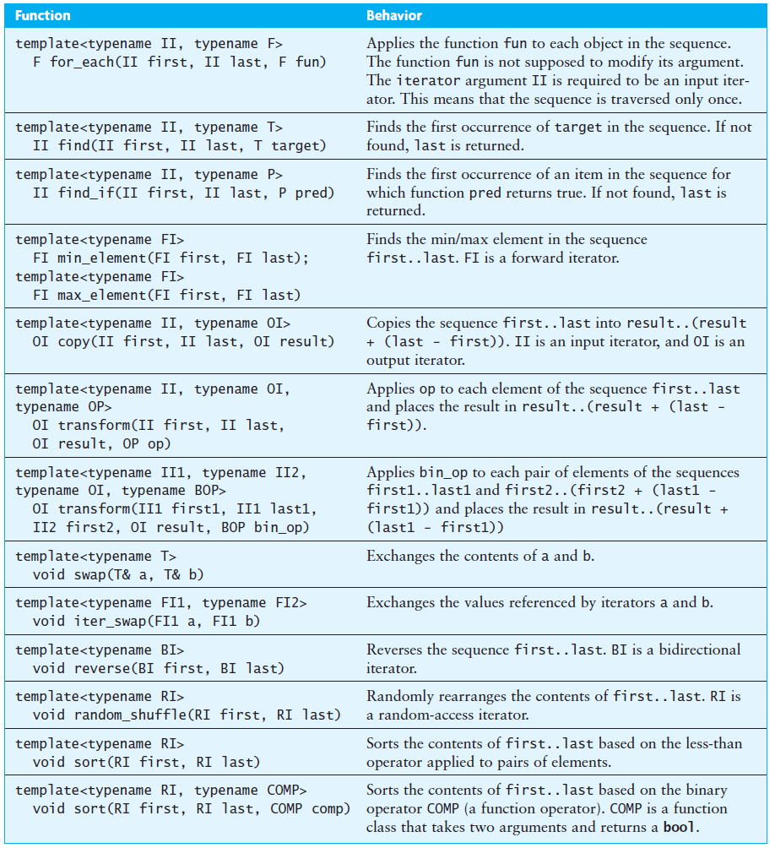

The Algorithm Library (cont.)

Slide 199
The Algorithm Library (cont.)
The template functions perform fairly standard operations on containers, such as
Applying the same function to each element (for_each)
Copying values from one container to another (copy)
Searching a container for a target value (find, find_if)
Sorting a container (sort)
Most of these algorithms are simple loops, such as the find that was just discussed. You may then ask yourself, “Why not just code the loop when I need it?”
Two reasons:
To avoid “reinventing the wheel”—the library contains validated versions of these algorithms, whereas if you recode them yourself, you may have errors that you will have to fix rather than avoiding them in the first place
The compiler can be designed to generate more efficient code when instantiating the library version of the algorithm than if you were to hand-code the equivalent C++ code

Slide 200
The Algorithm Library (cont.)
This fragment copies the contents of a_list into a_vector
a_vector.resize(a_list.size());
copy(a_list.begin(), a_list.end(), a_vector.begin());
The first statement sets the size of a_vector to the same as a_list. It then calls template function copy to copy the elements from a_list to a_vector

Slide 201
The Algorithm Library (cont.)
This fragment sorts the elements in vector<int> a_vector then it accumulates and displays the sum of the elements
sort(a_vector.begin(), a_vector.end()); // Sort the vector.
// Accumulate the sum.
int sum = accumulate(a_vector.begin(), a_vector.end(), 0);
cout << "Sum is " << sum << endl;
// Check first element.
if (*a_vector.begin() !=
*min_element(a_vector.begin(), a_vector.end()))
cerr << "Error in sort\n";
// Check last element.
vector<int>::iterator iter(a_vector.end() - 1);
if (*iter != *max_element(a_vector.begin(), a_vector.end()))
cerr << "Error in sort\n";

Slide 202
The swap Function
The swap function is defined as:
template<typename T>
void swap(T& x, T& y) {
T temp(x); // temp is a copy of x.
x = y; // Assign y to x.
y = temp; // Assign the copy of x to y.
}

Slide 203
The swap Function (cont.)
We used template function swap in Section 4.3 to exchange the contents of two variables:
std::swap(num_items, other.num_items);
std::swap(current_capacity, other.current_capacity);
std::swap(the_data, other.the_data);
The first two calls exchange a pair of int values; the last call exchanges the pointers to the two arrays

Slide 204
Specializing the swap Function
But what if we have two vector variables v1 and v2 and execute the statement
swap(v1, v2);
In this case,
The copy constructor will be invoked to make a copy of v1 into temp
The assignment operator will be called to assign v2 to v1
temp is assigned to v1 using the assignment operator again
The destructor is called to destroy temp

Slide 205
Specializing the swap Function
Since the standard swap uses the assignment operator, which in turn uses the copy constructor and swap member functions, we are making unnecessary copies
We can avoid this by providing what is known as a specialization of the swap function as follows:
template<typename Item_Type>
inline void swap(vector<Item_Type>& x, vector<Item_Type>& y) {
x.swap(y); }
By providing this function definition, the compiler will instantiate the vector::swap member function rather than the standard function swap when it is called with arguments of type vector
This function definition is placed in the vector.h file after the class definition

Slide 206
Function Objects (cont.)
The function call operator (operator()) can be overloaded by a class
A class that overloads this operator is called a function class, and an object of such a class is called a function object

Slide 207
Function Objects (cont.)
As an example, we may want to find a value divisible by another value. We can create a function class Divisible_By whose constructor takes the divisor as an argument:
class Divisible_By {
private:
int divisor;
public:
Divisible_By(int d) : divisor(d) {}
bool operator()(int x) {
return x % divisor == 0;
}
};

Slide 208
Function Objects (cont.)
As an example, we may want to find a value divisible by another value. We can create a function class Divisible_By whose constructor takes the divisor as an argument
class Divisible_By {
private:
int divisor;
public:
Divisible_By(int d) : divisor(d) {}
bool operator()(int x) {
return x % divisor == 0;
}
};
Data field divisor stores the number we want to divide by

Slide 209
Function Objects (cont.)
As an example, we may want to find a value divisible by another value. We can create a function class Divisible_By whose constructor takes the divisor as an argument
class Divisible_By {
private:
int divisor;
public:
Divisible_By(int d) : divisor(d) {}
bool operator()(int x) {
return x % divisor == 0;
}
};
The definition of operator() specifies that the function result will be determined by testing the remainder resulting from the division of the function argument (int x) by the value of divisor

Slide 210
Function Objects (cont.)
As an example, we may want to find a value divisible by another value. We can create a function class Divisible_By whose constructor takes the divisor as an argument
class Divisible_By {
private:
int divisor;
public:
Divisible_By(int d) : divisor(d) {}
bool operator()(int x) {
return x % divisor == 0;
}
};
The expression Divisible_By(3) creates a function object that returns true if the argument passed to it is divisible by 3

Slide 211
Function Objects (cont.)
As an example, we may want to find a value divisible by another value. We can create a function class Divisible_By whose constructor takes the divisor as an argument
class Divisible_By {
private:
int divisor;
public:
Divisible_By(int d) : divisor(d) {}
bool operator()(int x) {
return x % divisor == 0;
}
};
The expression Divisible_By(5) creates a function object that tests for integers divisible by 5

Slide 212

Function Objects (cont.)
Template parameter II is a placeholder for an input iterator; template parameter P is a placeholder for a function class with an operator() that returns a bool value

Slide 213
Function Objects (cont.)
// Find first number divisible by 3 in list_1.
list<int>::iterator = iter;
iter = find_if(list_1.begin(), list_1.end(), Divisible_By(3));
if (iter != list_1.end())
cout << "The first number divisible by 3 is " << *iter
<< endl;
else
cout << "There are no numbers divisible by 3\n";
// Find first number divisible by 5 in list_1.
iter = find_if(list_1.begin(), list_1.end(), Divisible_By(5));
if (iter != list_1.end())
cout << "The first number divisible by 5 is " << *iter
<< endl;
else
cout << "There are no numbers divisible by 5\n";
The template function find_if is instantiated with an iterator bound to
list<int>::iterator and with P bound to Divisible_By. This instantiation is called with two different function objects, but these function objects have the same type

Slide 214
Function Objects (cont.)
// Find first number divisible by 3 in list_1.
list<int>::iterator = iter;
iter = find_if(list_1.begin(), list_1.end(), Divisible_By(3));
if (iter != list_1.end())
cout << "The first number divisible by 3 is " << *iter
<< endl;
else
cout << "There are no numbers divisible by 3\n";
// Find first number divisible by 5 in list_1.
iter = find_if(list_1.begin(), list_1.end(), Divisible_By(5));
if (iter != list_1.end())
cout << "The first number divisible by 5 is " << *iter
<< endl;
else
cout << "There are no numbers divisible by 5\n";

Slide 215
Function Objects (cont.)
On the next slide, the function class Square_Diff saves its argument in data field mean
The function call operator() subtracts the value saved in mean from the input value and then returns the square of this difference

Slide 216
Function Objects (cont.)
class Square_Diff {
private:
double mean;
public:
/** Construct a Square_Diff object remembering
the value of the mean.
@param m The mean to be remembered
*/
Square_Diff(double m) : mean (m) {}
/** Subtract the mean from the input value and
return the square of the difference.
@param x The input value
@return (x - mean) squared
*/
double operator()(double x) {
double diff = x - mean;
return diff * diff;
}
};

Slide 217

Function Objects (cont.)

Slide 218
Function Objects (cont.)
To get the mean, we first compute the sum of the data stored in container input_data (using function accumulate) and then divide by the number of values
// Compute the sum of the input.
double sum =
accumulate(input_data.begin(), input_data.end(), 0.0);
// Compute the mean.
double mean = sum / input_data.size();

Slide 219

Function Objects (cont.)
We can use the transform algorithm with function class Square_Diff to transform the values in input_data into a sequence of squared deviations

Slide 220
Function Objects (cont.)
The following statement applies the function call operator in function class Square_Diff to each element of input_data
Because the third parameter is an iterator that points to the first element in input_data, the result of each call is saved back in input_data
// Load the square deviation values.
transform(input_data.begin(), input_data.end(),
input_data.begin(), Square_Diff(mean));

Slide 221
Function Objects (cont.)
Finally we use accumulate to compute the sum of the squared deviations, and then the standard deviation is computed
// Compute the sum of the squared deviations.
double sum_sq_dev =
accumulate(input_data.begin(), input_data.end(), 0.0);
// Compute the standard deviation.
double stdev = sqrt(sum_sq_dev / (input_data.size() - 1.0));

